Slide 1
Claude 101

Slide 2
What is Claude
Claude is built to be helpful, harmless, and honest: At a high level, Claude is guided by principles that help it avoid toxic or discriminatory outputs, avoid helping humans engage in illegal or unethical activities, and broadly behave as a helpful, honest, and harmless AI system. This approach, called Constitutional AI, means Claude is trained to align with human values and operate transparently.
Claude is more than a chatbot: Claude is capable of a wide variety of conversational and text processing tasks while maintaining a high degree of reliability and predictability, including summarization, search, creative and collaborative writing, Q&A, coding, and more. Think of Claude as a thought partner who can help you tackle complex problems, and work through challenging situations, not just answer simple questions.
Claude is designed to be steerable and collaborative: Claude can take direction on personality, tone, and behavior, and customers report that Claude is much less likely to produce harmful outputs, easier to converse with, and more steerable—so you can get your desired output with less effort.
You can access Claude wherever you work: Claude apps are available to all plan types—Free, Pro, Max, Team, and Enterprise. Your conversations, projects, memory, and preferences sync across all devices when you're signed in. Whether you're at your desk or on the go, Claude is available through web, desktop, and mobile apps.

Slide 3
Understanding Claude's capabilities
Claude can help with wide range of tasks & can be used to automate & augment the work
Writing and content creation: Claude can collaborate with you on social media posts, professional emails, and complex reports. Because Claude is trained to take direction on personality and tone, you can iterate together on structure and clarity until your voice comes through clearly.
Research and analysis: Claude helps you explore research angles, compile findings, and analyze data to surface meaningful insights. You can upload documents and Claude will help you make sense of complex information—this is enabled by Claude's large context window, which can ingest 200K+ tokens (about 500 pages of text or more), with up to 1M tokens available on Pro, Max, Team, and Enterprise plans when using Opus 4.6. This allows Claude to consider extensive materials in a single conversation.
Coding assistance: Claude Opus 4.6 is most powerful model yet and the best coding model in the world. This strong performance on real-world coding tasks means Claude can help you write, debug, and explain code across multiple programming languages.
Problem-solving and reasoning: Claude handles complex cognitive tasks, mathematical problems, strategic thinking and analysis, and research. Claude Opus 4.6 and Sonnet 4.6 are hybrid models offering two modes: near-instant responses and extended thinking for deeper reasoning. Anthropic Extended thinking allows Claude to work through problems step-by-step, making it well-suited for tasks that require careful analysis.
Learning new things: Whether you're learning a new skill, exploring unfamiliar domains, or working through complex challenges, Claude can adapt to your learning style and pace. Learning mode is a new Claude experience that guides your reasoning process rather than providing answers, helping develop critical thinking skills.

Slide 4
Ways to access Claude
Claude.ai (and the associated mobile and desktop apps) are the primary way most people interact with Claude. Here, you can ask questions, brainstorm ideas, create and edit documents, and a lot more. Claude.ai is ideal for conversations, writing assistance, research, analysis, and creating files. This is our focus in this course.
Claude Code is an agentic coding tool that is designed for developers but can be used for all kinds of file manipulation on your desktop. Claude Code can directly edit files, run commands, and create commits.
Claude and Slack brings Claude directly into your team's communication tool. You can chat with Claude in the AI assistant header from any channel or conversation, or by mentioning @Claude in threads. When you connect Slack to Claude, Claude searches your workspace's channels, direct messages, and shared files to find the context you need for better responses and research.
Claude for Excel lets you work directly with Claude in a sidebar in Microsoft Excel, where Claude can read, analyze, modify, and create new Excel workbooks. Claude for Excel is best for model analysis, assumption updates, error debugging, template population, formula explanations, and multi-tab navigation.

Slide 5
Using Claude
Claude is a powerful, intelligent collaborator that amplifies your capabilities across all of your work. Claude brings AI intelligence, but you bring the context and expertise that makes the work meaningful.
The best approach when speaking to Claude is like you would a coworker—naturally, concisely, and conversationally.
Before your next conversation with Claude, consider: setting the stage (your role, objectives, and context), defining the task (what action you want Claude to take), and specifying rules (style, tone, and examples).
When you upload relevant documents or background information into a chat, Claude considers that content in its response—think of it as a shortcut so Claude can understand what your needs are.
The real power of Claude comes with continued and frequent communication, not just one-off prompts.

Slide 6
Writing effective prompts
All interactions with Claude begin with a prompt, and these prompts, combined with other context, impact Claude's response. The best approach when speaking to Claude is like you would a coworker—naturally, concisely, and conversationally.
Consider few things below:
  Setting the stage: What is your role and what are your objectives? Is there context about your work that Claude should know about?
  Defining the task: What action do you want Claude to take? Do you want Claude to write, analyze, build, or something else?
  Specifying rules: What's the style or tone you want Claude to use? Are there examples that you can attach to show Claude what you're looking for?
This prompt framework is adapted from the 4D Framework for AI Fluency, developed through research collaboration between Professor Rick Dakan (Ringling College of Art and Design) and Professor Joseph Feller (University College Cork). The framework identifies four core competencies—Delegation, Description, Discernment, and Diligence—that enable effective collaboration with AI.

Slide 7
If you'd like Claude to consider specific preferences in every response, go to Settings > General > 'What personal preferences should Claude consider?' to set preferences that apply to every conversation.
Iterating on Claude's responses
  Conversations with Claude are meant to be iterative. Chaining bite-sized prompts together allows for a natural dialogue where you guide the conversation based on Claude's replies.
  If Claude's first response isn't quite what you wanted, you have several options:
    Ask follow-up questions
    Provide Feedback
    Redirect or Restart
    Pro Tip
Personalizing Claude with two features
  It automatically saves Role, preferences, past decision, working style, it can be cleared anytime
  Styles let you customize how Claude communicates. Choose from preset options — like concise, formal, or explanatory — or create your own custom style by describing exactly how you want Claude to write. Once set, your style applies across all conversations automatically.

Slide 8
Common challenges and how to fix them
Challenge | What's happening | Try this
Claude's response is too generic | Your prompt didn't include enough context about your specific situation | Add details about your audience, role, or constraints. Instead of "Write an email about the project delay," try "Write an email to our enterprise client explaining that the software integration will be delayed by two weeks. They've been patient so far but this is the second delay. Keep it professional but apologetic."
The response is too long (or too short) | Claude is guessing at appropriate length | Be explicit: "Give me a two-paragraph summary" or "Keep this under 100 words" or "I need a comprehensive analysis—length isn't a concern."
Claude didn't follow my format | Claude understood what you want but not how you want it presented | Show, don't just tell. Provide an example of the format, or describe the structure explicitly: "Use bullet points with bold headers for each section."
I got confident-sounding information that turned out to be wrong | Claude occasionally generates plausible but incorrect information, especially with specific facts or niche topics | For high-stakes work, verify key facts independently. Ask Claude to cite sources or indicate confidence level. Enable web search to ground responses in current information.
The tone isn't right | Claude defaults to helpful and professional, which may not match your needs | Describe the tone in plain language: "Make this more conversational" or "This should sound authoritative and formal." Provide an example of writing in the style you want.

Slide 9
The Iteration Mindset
One of the most important shifts when working with Claude is recognizing that your first prompt rarely produces a perfect result. Think of your initial prompt as the start of a conversation, not a one-shot request.
Effective Claude users:
  Treat first drafts as starting points. Review what Claude produces, identify what's working and what isn't, then refine.
  Give specific feedback. "Make it shorter" is fine, but "Cut the first two paragraphs and make the conclusion more action-oriented" is better.
  Know when to start fresh. If a conversation has gone off track, sometimes it's faster to open a new chat with a clearer prompt than to try to redirect.

Slide 10
What is AI Fluency?
AI Fluency is the ability to collaborate effectively with AI tools—not just knowing which buttons to click, but developing the judgment to use AI well across different situations.
The 4D Framework for AI Fluency, developed through research collaboration between Professor Rick Dakan (Ringling College of Art and Design) and Professor Joseph Feller (University College Cork), identifies four core competencies that, when combined, can help you make the most of your AI interactions:
  Delegation: Deciding on what work should be done by humans, what work should be done by AI, and how to distribute tasks between them. Includes understanding your goals, AI capabilities, and making strategic choices about collaboration
  Description: Effectively communicating with AI systems. Includes clearly defining outputs, guiding AI processes, and specifying desired AI behaviors and interactions.
  Discernment: Thoughtfully and critically evaluating AI outputs, processes, behaviors and interactions. Includes assessing quality, accuracy, appropriateness, and determining areas for improvement.
  Diligence: Using AI responsibly and ethically. Includes making thoughtful choices about AI systems and interactions, maintaining transparency, and taking accountability for AI-assisted work.

Slide 11
Evaluating Claude for your workflows
As you start integrating Claude into more of your work, you might wonder: how do I know if Claude is actually good at this particular task?
This is where Discernment becomes essential. Evals (short for evaluations) are a way to develop intuition for assessing Claude's outputs on the tasks that matter to you. They're systematic ways to test how well Claude performs on specific types of tasks that matter to you.
Why evals matter
  Your work is unique. Claude might excel at drafting marketing copy but need more guidance for technical documentation in your specific domain. Running simple evals helps you:
  Understand where Claude adds the most value in your workflow
  Identify tasks where you'll need to provide more context or examples
  Build confidence in Claude's outputs for recurring tasks

Slide 12
Navigating the Claude desktop app: Chat, Cowork, Code
The Claude desktop app gives you three ways to work with Claude: Chat, Cowork, and Code.
Chat is the same Claude you know from claude.ai, plus quick entry, screenshots, dictation, and connectors that come from running natively on your computer.
Cowork is an agentic tool — you give it a goal, connect it to your tools and resources, and let it do the work. With Cowork, Claude has the reach and the room to do more. This broader scope allows it to conduct more thorough research and analysis, and produce more complex documents and deliverables.
Code is for building software, from writing and testing code to deploying it.
Cowork and Code run on the same engine. Both are Claude Code underneath — local to your machine, capable of independent work, able to spin up sub-agents and sustain long tasks. This allows Claude to work through larger tasks on its own, like research and writing or building software.

Slide 13
Chat
Chat excels when you need to ask questions, brainstorm, draft, or work through problems back and forth.
Screenshot & Window sharing can be done
Dictation: Instead of typing Dictation is also possible. It is useful when you are away from Keyboard

Slide 14
Cowork
Claude Cowork is built for work that takes real effort: pulling information from many sources, making sense of it, and producing something finished.
In Cowork, Claude can multitask, tackling different parts of a project at a time, so it has the scope to draw from more sources and the stamina to see things through. Thorough research briefs, cross-source financial analysis, end-to-end contract review, polished slide decks from material spread across sources.
Before starting, Claude often asks a short set of questions to pin down what you need: scope, format, constraints. It builds a plan you can review in the sidebar. As it works, you see the task come together: sources it's drawing from, files taking shape, progress through the plan. You can run multiple tasks at once, each in its own conversation, and switch between them from the sidebar.

Slide 15
Folder Access: Point Claude to a folder on computer and it will read relevant data & save finished work back to the same place. Files can be uploaded, content can be pasted into the conversation or connect tools that pull in what Claude needs
Scheduled Tasks: Claude can handle recurring work on a schedule like daily, weekly or monthly. You define the task and when it should run, and Claude handles it automatically each time the app is open. If your computer or the app was closed when a task was due, it catches up when you're back.
Subagents: Claude breaks tasks into subtasks, assigns each to a subagent with its own context, and coordinates the results, giving you one finished deliverable.
Dispatch: Claude Dispatch is a feature allowing users to assign tasks via the Claude mobile app (iOS/Android) that are executed by Claude Desktop on their computer.
Projects: Projects in Cowork lets you group related tasks into dedicated workspaces with their own files, context, instructions, and memory. They live locally on your desktop and are built around the tasks you run through Cowork.
Browser Use: Claude’s "browser use" capability allows the AI to directly interact with websites, act as a virtual user, and automate browser tasks within Chrome or Edge.

Slide 16
Computer Use: Claude AI's "computer use" feature allows the AI to interact with a computer similarly to a human—viewing the screen, moving the cursor, clicking, and typing. Claude follows a priority order: connectors first, then Chrome, then screen interaction, so it always picks the fastest, most reliable path. You'll see a permission prompt before Claude accesses each app, and you can set up a blocklist for anything you want off-limits.
Plugins: Plugins give Claude capabilities it doesn't have on its own: pulling live financial data, searching your company's internal knowledge base, or working within a specific compliance framework.
Protected environment: Cowork runs in a contained space on your computer. Claude can read, create, and edit files within the folders you share, but can't access anything outside them.
Cowork is available to Pro, Max, Team, and Enterprise users, with new capabilities being added regularly.

Slide 17
Code
The Code tab gives you access to the power of Claude Code, running directly inside the desktop app. This gives you a full development environment for building software. Claude Code is an agentic, terminal-based coding assistant by Anthropic that reads, writes, edits, and runs code across your local projects. Where Cowork runs in a contained workspace limited to the folders you share, Code runs directly in your project with full access to your file system, terminal, and development tools.
Local: You select a folder on your computer and Claude works directly with those files. Because it runs on your machine, Claude can read your project, access local tools, and run a development server you can preview in your browser.
Remote: You connect a GitHub repository and Claude works in a cloud environment. Sessions continue even if you close the app, so you can start a big refactor and check back later. Good for larger codebases or when you want to keep development off your local machine.

Slide 18
Three interaction modes let you control how much Claude does on its own:
  Ask: Claude proposes every change and waits for your approval. You review a visual diff and accept or reject before anything is modified.
  Code: Claude applies file changes automatically but checks before running terminal commands.
  Plan: Claude outlines its full approach before touching anything. A dedicated plan viewer lets you review and revisit the strategy as work progresses.
You can run multiple sessions across projects and filter them by status (Active or Archived) and environment (Local or Cloud) from the sidebar.
The Code tab is available on Pro, Max, Team, and Enterprise users.

Slide 19
Comparison
 | Chat | Cowork | Code
Optimized for | Quicker exchanges: exploring ideas, iterative drafting, quick answers, learning through dialogue | Complex or sustained work: research, analysis, file organization, producing finished documents and deliverables | Building software: writing, testing, running and deploying code
Key features | Quick entry, dictation | Work from local folders, plugins, subagents, scheduled tasks | Ask/Code/Plan modes, visual diffs, git integration, local and remote environments
Tools and extensions | Connectors, Skills, Claude in Chrome | Connectors (local and remote), Skills, Claude in Chrome, Plugins, Computer Use | Connectors, Skills, Claude in Chrome, Plugins, Hooks

Slide 20
Projects
Projects are self-contained workspaces with their own memory, chat histories, knowledge bases, and customized instructions. Think of them as dedicated environments for specific work streams.
Project knowledge enhances Claude's understanding by letting you upload relevant documents that Claude references across all chats within that project. No more re-uploading the same files each time.
Project instructions guide Claude's behavior—you can specify tone, expertise level, response style, and more. These instructions apply to every conversation within the project.
Projects scale automatically. When your knowledge base approaches context limits, Claude seamlessly enables Retrieval Augmented Generation (RAG) mode to expand capacity by up to 10x while maintaining response quality.
For Claude for Work users, projects enable collaboration. Share projects with teammates so everyone benefits from the same context, instructions, and accumulated knowledge.

Slide 21
What are Projects?
Projects are ideal for storing knowledge Claude should reference, organizing related chats around a specific topic or work area, and collaborating with team members who need access to the same shared context.
When to use Projects
  Projects are particularly valuable when you're working on something ongoing—not just a one-off question. Consider creating a project when you have a workflow with:
    Reference materials you'll use repeatedly (meeting notes, survey results, reports, historical data, etc.)
    Consistent requirements for how Claude should respond (always use formal language, always cite sources, always follow our template)
    Team collaboration needs where multiple people should work from the same foundation

Slide 22
Collaboration features
For users on Claude for Work (Team and Enterprise) plans, projects become even more powerful through collaboration features.
  Permission levels: When sharing a project, you can choose from three permission levels:
    Can view: Members can see project contents, access knowledge, and chat—but can't make changes. Think of this as read-only access with discussion rights.
    Can edit: Members have full collaboration power. They can modify instructions, update knowledge, manage other members, and actively contribute to the project.
    Owner: Project creators control everything, including who sees the project. They can share with specific people or make projects visible to the entire organization.
Sharing a project: To share a project.
  Open the project you want to share
  Click the "Share project" button to the right of the project name
  Add individual members using their name or email, or copy and paste a list of email addresses for bulk sharing (in this case, the project will show up in their "Shared with you" section)
  Or, share with "Everyone at [your organization]" to make your project discoverable within the Team tab
  Team members will receive email notifications when you share a project with them, and they can find shared projects in their "Shared with me" tab.

Slide 23
Best practices for projects
Start focused, then expand. Begin with a specific use case rather than trying to create one project for everything. You can always add more content as you go.
Keep your knowledge base current. Outdated documents can lead to outdated responses. Review and update your project knowledge periodically.
Write clear instructions. Be specific about what you want. Vague instructions lead to inconsistent results.
Name your documents descriptively. (e.g., 'Q4-2025-Sales-Report.pdf' not 'report.pdf') and group related files together. Claude uses filenames and proximity to understand relationships between documents.
Reference documents by name. When asking questions, you can mention specific documents to help Claude focus its search: "Based on our Q3 report, what were the top customer concerns?"

Slide 24
What are artifacts?
Artifacts are standalone, interactive outputs that Claude creates in a dedicated window alongside your conversation. Instead of getting a long block of code or text buried in the chat, you see your content rendered and ready to use—whether that's a working website, an interactive chart, or a document you can immediately download.
Claude automatically creates an artifact when content meets certain criteria:
  It's significant and self-contained, typically over 15 lines
  It's something you're likely to want to edit, iterate on, or reuse
  It represents complex content that stands on its own without needing the surrounding conversation
  It's content you'll want to reference or use later

Slide 25
Common artifact types
Claude can create different of artifacts, each suited to different needs:
  Documents (including markdown, plain text, Word docs, PDFs, PowerPoint, and Excel): Great for anything text-heavy that you'll want to export or continue editing — like meeting notes, reports, project plans, blog posts, and other written content.
  Code snippets: Working code in any programming language—Python, JavaScript, C++, and more. You can view the code, copy it, or download it to use in your own projects.
  HTML pages: Complete web pages with HTML, CSS, and JavaScript in a single file. Perfect for landing pages, forms, interactive demos, or quick prototypes.
  SVG images: Scalable vector graphics for logos, icons, illustrations, and other visual elements. These render directly in the artifact window so you can see exactly what you're getting.
  Mermaid diagrams: Flowcharts, sequence diagrams, Gantt charts, org charts, and more. Describe the relationships you want to visualize, and Claude will create a diagram you can refine
  React components: Interactive UI elements with real functionality—calculators, dashboards, games, data visualizations. These aren't just mockups; they include actual logic and respond to user input.
When Claude generates an artifact, it appears in a dedicated window to the right of your conversation. From here, you can:
  View different formats: Toggle between a preview (how it looks) and the underlying code
  Copy content: Click the copy icon to grab the content for use elsewhere
  Download files: Save the artifact as a file to your computer
  View code: See exactly what Claude generated under the hood

Slide 26
Sharing and publishing artifacts
Once Artifact is created, there are several options for sharing it:
  Copy or download: For personal use or sharing via other channels, use the copy or download buttons in the lower right corner of the artifact window.
  Share within your organization (Claude for Work): Team and Enterprise users can share artifacts internally with colleagues. The shared artifact stays within your organization and requires team authentication to access.
  Publish publicly: For free, Pro, and Max users, you can publish artifacts to make them accessible to anyone with the link. When you publish:
    Only the selected version becomes public (your chat remains private)
    Anyone can view and interact with the artifact without a Claude account
    Others can "remix" your artifact—opening it in their own Claude conversation to modify and build upon it
  You can unpublish at any time by returning to that artifact and removing public access.

Slide 27
Tips for getting the most from artifacts
Be specific about what you want.
Describe the end user. Telling Claude who will use the artifact helps it make appropriate design choices.
Iterate incrementally. Ask Claude to add one feature or make one change at a time. This makes it easier to identify what's working and catch issues early.
Request artifacts when needed. If you ask for something substantial and Claude responds in the chat instead of creating an artifact, just say "Please create that as an artifact."

Slide 28
Working with skills
What are Skills?
  Skills are folders of instructions, scripts, and resources that Claude loads dynamically to improve performance on specialized tasks. Think of them as expertise packages—they teach Claude how to complete specific tasks in a repeatable way.
  File creation capabilities are powered by Skills running behind the scenes. But Skills go far beyond document creation. Custom Skills can codify entire repeatable workflows — a quarterly variance analysis methodology, a brand voice review process, or a compliance checklist — so Claude follows the same rigorous steps every time.
Types of Skills
  There are two categories of Skills you'll encounter:
    Anthropic Skills are created and maintained by Anthropic. These include enhanced document creation capabilities for Excel, Word, PowerPoint, and PDF files. Anthropic Skills are available to all paid users and Claude invokes them automatically when relevant—you don't need to do anything special to use them.
    Custom Skills are ones you or your organization create for specialized workflows and domain-specific tasks. E.g.: create a skill that applies your company's brand guidelines to presentations, structures meeting notes in a specific format

Slide 29
Enabling Skills
Skills are currently available as a feature preview for users on Pro, Max, Team, and Enterprise plans. To use Skills, you'll need to have Code execution and file creation enabled, since Skills require Claude's secure sandboxed computing environment to function.
Here's how to enable Skills:
  Navigate to Settings > Capabilities
  Ensure that Code execution and file creation is toggled on
  Scroll to the Skills section
  Toggle individual skills on or off as needed
For Enterprise plans, organization Owners must first enable both Code execution and Skills in Admin settings before individual members can access them.
For Team plans, this feature preview is enabled by default at the organization level.
Once enabled, you'll see available Skills listed in your settings, including Anthropic's built-in Skills and any custom Skills you've uploaded.

Slide 30
Using Skills in practice
Claude handles skill selection automatically based on your request. Here are some examples of prompts that would invoke Skills:
When Claude uses a Skill, you'll see it mentioned in Claude's chain of thought as it works. The output will be a downloadable file you can save to your computer or directly to Google Drive.
Claude works with you on slides, spreadsheets, and contract redlines. To use these capabilities you'll need to give Claude access to external data sources.

Slide 31
Security considerations
Because Skills can include executable code, it's important to use them thoughtfully:
  Only install custom Skills from trusted sources
  Anthropic's built-in Skills are tested and maintained by Anthropic
  Custom Skills you upload are private to your individual account
  If you're installing a custom Skill from an external source, review its contents before use to understand what it does.
Creating custom skills
  Custom Skills let you teach Claude your specific workflows, brand guidelines, and ways of working—so Claude can apply that knowledge automatically whenever it's relevant.
  The easiest way to create a custom Skill is through conversation with Claude itself.

Slide 32
Here's how to create a Skill through conversation:
  Start a new chat and tell Claude what you want to create. For example: "I want to create a skill for writing quarterly business reviews“
  Answer Claude's questions. Claude will interview you about your workflow, asking things like: What should this skill do? What makes good output for this type of work? Can you give examples of when you'd use this skill?
  Upload reference materials if you have them. Templates, style guides, brand assets, or examples of work you're proud of all help Claude understand exactly what you're looking for.
  Save your skill. When finished, Claude generates a file containing your properly structured skill. All you have to do is save it and the skill will be ready for Claude to use.
  See your skills. Find the Customize tab in the left sidebar. There you can see all of the skills that are available to you and even edit the skills you use manually or by chatting with Claude. Your custom Skill will appear in your Skills list alongside Anthropic's built-in Skills. From that point forward, Claude will automatically invoke it whenever you work on relevant tasks—no manual triggering needed. You can improve your skills with iteration — ask Claude to edit a skill and it will update the files for you.

Slide 33
Skills vs. Projects
Projects are knowledge hubs. They hold the reference materials Claude needs to understand your work—project specs, meeting notes, research documents. When you upload files to a project, Claude draws on that information across every conversation within that project.
Skills are procedural machines. They encode how Claude should execute a task—the specific steps, order of operations, and methodology you want followed every time. Skills shine when you have repeatable workflows you want Claude to run consistently.
 | Projects | Skills
Purpose | Store knowledge Claude references | Define processes Claude executes
Best for | Long-term context, reference materials, team collaboration | Repeatable workflows, multi-step tasks, consistent methodology
Example | Customer hub, research buddy, feedback generator | Process guidelines (like brand or legal), Blog drafting, PDF creation
Persistence | Knowledge available across all chats in the project | Instructions applied when the skill is invoked

Slide 34
Connecting your tools
Connectors transform Claude from an assistant into an informed collaborator by giving Claude access to the same tools, data, and context that you use every day. Instead of starting every conversation from scratch, Claude can work directly with your actual information.
Connectors allow Claude to read information and perform actions on your behalf. Depending on the connector and permissions you grant, Claude can search your files, retrieve documents, analyze data, create new content, update records, and execute tasks across your connected applications—all from within your conversation.
The Model Context Protocol (MCP) powers connectors. Think of MCP like USB-C for AI—a universal standard that allows Claude to connect to many different applications through a single, consistent interface. This open standard means developers can build connectors for any tool, and those connectors work seamlessly with Claude.
There are two types of connectors: web connectors and desktop extensions. Web connectors link Claude to cloud services like Google Drive, Notion, Slack, and Asana. Desktop extensions run locally on your computer through the Claude Desktop app, giving Claude access to local files and native applications.

Slide 35
Finding and connecting tools
Anthropic maintains a directory of recommended connectors at claude.ai/directory. The directory is organized into two tabs:
  Web: Cloud services and applications (Gmail, Notion, Slack, Asana, Linear, Stripe, and many more)
  Desktop extensions: Local tools that run on your computer through the Claude Desktop app
To browse available connectors, you can also click the "Search and tools" button in the lower left of the chat window, then select "Add connectors."

Slide 36
Setting up a web connector
Here's how to connect a cloud service:
  Find the connector: Navigate to claude.ai/directory or click "Search and tools" > "Add connectors" in any chat
  Click Connect: Select the connector you want to add
  Authenticate: You'll be redirected to the service's login page. Sign in with your existing credentials
  Grant permissions: Review the specific permissions Claude is requesting, then authorize access
  Test the connection: Return to Claude and try a simple request, like "Can you access my [tool name]?"
Once connected, Claude can search, read, and in some cases take actions within that service—depending on the permissions you've granted.

Slide 37
Desktop extensions
Desktop extensions require the Claude Desktop app rather than the web interface. These extensions let Claude interact with local applications, your file system, and native features on macOS or Windows.
Some desktop extensions include:
  Local file access for reading and organizing documents
  Browser control for automated web tasks
  Native application integration (like Figma for design work)
To install a desktop extension:
  Download and install the Claude Desktop app
  Open the app and navigate to Settings > Extensions
  Browse available extensions and click Install
  Follow any additional setup steps specific to that extension
Once you've connected your tools, Claude considers them when responding to your requests.

Slide 38
Security and permissions
When you connect Claude to external services, you're granting it access to read—and sometimes modify—data within those services. Here are some important considerations:
  Scoped access: Permissions are specific to what the connector needs and you can toggle individual permissions on and off within each application's menu.
  Claude sees what you see: Claude can only access data you have access to. Connecting your work email doesn't give Claude access to your CEO's inbox—only your own.
  Revocable at any time: You can disconnect a service through Claude's settings or through the third-party service's security settings. Just as with Skills, you can also find or build custom connectors. Exercise the same caution — only install connectors from trusted sources.

Slide 39
Enterprise search
Enterprise Search adds a dedicated "Ask {Your Org Name}" option to your sidebar. This is designed specifically for finding and synthesizing knowledge buried across your company's tools and data sources. Think of Enterprise Search as a pre-built Project for your entire organization — your company's knowledge base is already loaded, so you can jump right in to get context-aware responses to your questions. Enterprise Search is specifically designed for information gathering, using custom instructions configured by the Anthropic team.
What can you ask?
  Enterprise Search is particularly valuable for questions that span multiple sources or require synthesizing information from across your organization. Here are some common use cases:
    Getting up to speed: "What are the current blockers on the Platform project?"
    Policy and process questions: "How do I submit an expense report?"
    Research and analysis: "Summarize discussions about the Q4 product roadmap"
    Onboarding new team members: "How does our authentication system work?"
    Performance and project tracking: "Summarize team contributions to the Infrastructure initiative"
  When you ask a question, Claude searches across all your connected tools—such as SharePoint documents, Slack conversations, Gmail threads, and Google Drive files—and synthesizes information into a unified response. Plus, it always cites its sources so you can get the full context.

Slide 40
Setting up Enterprise Search
Enterprise Search requires a two-step setup process: first an admin configures it for the organization, then individual users authenticate with their personal accounts.
  For admin (Owners)
  The Enterprise Search project is enabled by default for all Team and Enterprise organizations, but an Owner needs to complete the initial setup before team members can use it
  Click "Ask Your Org" in the left sidebar.
  Click "Set up for your org" to continue (or "Disable" to turn the feature off).
  Connect your organization's tools. You'll be required to choose a connector for Documents (like Google Drive or SharePoint) and Chat (like Slack or Microsoft Teams). Email is recommended but optional.
  Click "+ Add more" to set up any additional tools your team needs.
  Customize the project name. Whatever you enter will appear as "Ask [Name]" in everyone's sidebar.
  Add a description, then click "Finish set up.“
  Once setup is complete, the project becomes available to all members of your organization.

Slide 41
For Users
  After an admin has set up Enterprise Search, you'll see the "Ask {Org Name}" project starred in your sidebar. Here's how to get started:
    Click on the project in your sidebar.
    Follow the guided onboarding flow to connect to the recommended services.
    Authenticate with each service you want to search (Slack, Google, Microsoft 365, etc.).
    Start asking Claude questions about your organization's knowledge.
    The more connectors you enable, the more comprehensive your search results will be. You can always add more connectors later by clicking "Connect" in the project's Instructions section.

Slide 42
Research mode for deep dives
Research transforms how Claude finds and analyzes information. Instead of a single search, Claude operates agentically—conducting multiple searches that build on each other while determining exactly what to investigate next. It explores different angles of your question automatically and works through open questions systematically.
Research delivers comprehensive answers in minutes. Most reports complete in 5 to 15 minutes, though more complex investigations may take up to 45 minutes—work that would typically require hours of manual research.
Extended thinking is automatically enabled with Research. This powerful combination lets Claude both plan its approach thoughtfully and gather comprehensive information, breaking complex requests into manageable pieces.
Citations make verification easy. Research delivers thorough answers complete with easy-to-check citations, so you can trust Claude's findings and quickly verify sources yourself.

Slide 43
What is Research?
Research is an advanced feature that transforms Claude from a conversational assistant into a systematic investigator. When you enable Research, Claude doesn't just answer your question—it explores it from multiple angles, synthesizing information from across the web and your connected integrations. Think of it as having a skilled research assistant who can spend hours gathering information, cross-referencing sources, and compiling a comprehensive report—except it happens in minutes instead of hours. Research is particularly valuable when you need more than a quick answer. It's designed for situations where a thorough understanding requires pulling together information from multiple sources, comparing different perspectives, and synthesizing findings into actionable insights.

Slide 44
When to use Research
Understanding when to use Research versus other Claude capabilities helps you get the best results for your specific needs. Use Research when you need:
  Comprehensive reports that synthesize information from multiple sources
  In-depth analysis across the web and your connected integrations (like Google Workspace)
  Thorough investigations that would typically require hours of manual work
  Comparative analysis, such as evaluating competitors or vendor options
  Reports with citations you can verify
Research is ideal for tasks like:
  Market analysis and competitive research
  Planning complex projects, like team offsites or product launches
  Synthesizing information from your email, calendar, and documents
  Creating technical documentation that draws from multiple sources
  Preparing briefings that require current, verified information
Consider web search instead when:
  You need a quick, specific fact (like today's stock price or a company's address)
  The answer requires only one or two sources
  Speed matters more than comprehensiveness
Consider extended thinking instead when:
  You need deep reasoning on a complex problem that doesn't require external information
  You're working on mathematical problems, code debugging, or logical analysis
  The answer comes from reasoning through a problem rather than gathering information
Consider enterprise search instead when:
  You need answers that draw from your organization's internal knowledge — documents, Slack threads, emails, meeting notes
  You're onboarding and want to quickly find how your company handles something (like policies, processes, or past decisions)
  You're asking a question that's specific to your company, not the public web

Slide 45
How Research works
When you enable Research, you're activating an agentic, multi-step process that goes far beyond a simple web search. Claude autonomously decides what to search next based on what it has already found, pursuing leads and filling gaps without you needing to direct each step.
  Step 1: Claude plans its approach. When Research is enabled, extended thinking automatically activates. This lets Claude break down your request, identify what information it needs, and plan how to investigate different angles of your question.
  Step 2: Claude conducts multiple searches. Rather than running a single search, Claude conducts many searches that build on each other. It determines what to investigate next based on what it finds, pursuing promising leads and filling in gaps.
  Step 3: Claude synthesizes findings. After gathering information from multiple sources—including the web and any connected integrations like Gmail, Google Calendar, or Google Drive—Claude compiles everything into a comprehensive, well-organized report.
  Step 4: Claude provides citations. Every claim in Research reports links back to its source, making it easy to verify information and dig deeper when needed.

Slide 46
Tips for effective Research prompts
Since Research can take 5 to 45 minutes depending on complexity, investing time in crafting your prompt pays off. Here are some strategies:
  Be specific about your goals. Instead of "Tell me about the EV market," try "Analyze the electric vehicle battery market—identify key players, technology trends, and supply chain challenges that might affect investment decisions."
  Specify the sections or structure you want. Claude will organize its findings around the structure you provide. For example: "Compare venue options for a team offsite including: location and accessibility, meeting space and amenities, catering options, and pricing considerations."
  Include relevant constraints. Budget ranges, timelines, geographic requirements, and other parameters help Claude focus its research on relevant options.
  Ask Claude to help refine your prompt. If you're not sure how to frame your research question, you can even ask Claude to help you write a better Research prompt before enabling the feature.

Slide 47
Working with connected integrations
When you have Google Workspace or other integrations connected, Research becomes even more powerful. Claude can pull context from your emails, calendar, and documents alongside web research.
When using Research with integrations, you can steer Claude by saying things like "Pull relevant context from my Google Drive" or "Include insights from my recent emails on this topic.“
Pro tip: You can also turn off web search to do internal-only research across your connected tools — great for questions like "What did our team discuss about the Q3 launch across Slack and Docs?"

Slide 48
Claude Code
Claude Code is an agentic coding tool that works where you work — in your terminal, IDE, browser, or even in Slack. It understands your codebase, executes commands, and handles entire development workflows through natural language.
When to use Claude Code:
  You want to build features by describing what you need in plain English, and have Claude write the code, run tests, and create commits
  You need to debug issues by pasting error messages and having Claude analyze your codebase to identify and fix problems
  You're navigating an unfamiliar codebase and want to ask questions about how different parts work together
  You want to automate tedious tasks like fixing lint errors, resolving merge conflicts, or writing release notes
  You prefer working in your terminal alongside your existing IDE and development tools rather than switching to a separate interface

Slide 49
Claude in Slack
Claude integrates directly with Slack, allowing you to get help in channels and threads or bring Slack context into your Claude conversations.
When to use Claude in Slack:
  You want to draft responses to messages, summarize lengthy threads, or break down complex discussions without leaving Slack
  You need to prepare for meetings by having Claude pull together relevant conversations and shared documents from your workspace
  You're onboarding to a new team and want help understanding ongoing projects by reviewing channel history
  You want to hand off coding tasks directly from a bug report or feature discussion—just tag @Claude and it can spin up a Claude Code session using the surrounding context
  You need to quickly get answers about industry trends, technical concepts, or company information during a conversation

Slide 50
Claude for Excel
Claude for Excel brings Claude directly into Microsoft Excel through a sidebar, allowing you to analyze, understand, and modify spreadsheets through conversation.
When to use Claude for Excel:
  You're working with a complex multi-tab workbook and want to understand how specific formulas or calculation flows work across sheets
  You need to update assumptions or inputs across your model while preserving formula dependencies and relationships
  You're debugging spreadsheet errors like #REF!, #VALUE!, or circular references and want Claude to trace them to their source and suggest fixes
  You want to create new spreadsheets or populate existing templates with data while maintaining proper formula structure
  You need to quickly build pivot tables or charts to visualize your data

Slide 51
Claude for Chrome
Claude for Chrome is a browser extension that adds Claude as a sidebar in Google Chrome. It can observe what you're working on and take actions directly within your browser.
When to use Claude for Chrome:
  You want to summarize articles, research papers, or web pages while browsing
  You need help drafting email responses or managing your inbox
  You're filling out repetitive forms and want to automate the process
  You want to test website features or navigate multi-step workflows without manually clicking through each step
  You need a browsing assistant that maintains context as you move between tabs and tasks. This makes it great for pulling context from niche internal tools, CRMs, or dashboards.

Slide 52
Tool | Best for | Where it runs
Claude.ai | General tasks, research, writing, analysis, file creation | Web, desktop, and mobile apps
Claude Code | Software development, codebase navigation, git workflows | Terminal/command line, IDE, or your browser
Claude Cowork | Complex, multi-step tasks: research briefs, document creation, file organization, data analysis | Desktop (and mobile apps via Dispatch)
Claude/Claude Code in Slack | Team collaboration, meeting prep, quick answers in context | Slack workspace
Claude for Excel | Spreadsheet analysis, financial modeling, formula debugging | Microsoft Excel sidebar
Claude for Powerpoint | Slide creation, presentation editing, formatting and design | Microsoft Powerpoint sidebar
Claude for Chrome | Web research, email management, browser automation | Chrome browser sidebar

Slide 53
Summary
Claude is an AI assistant built to be helpful, harmless, and honest—more than a chatbot, it's a thinking partner for complex work
You can access Claude through web, desktop, and mobile apps, with your conversations syncing across devices
Effective prompts set the stage (context), define the task (action), and specify rules (format and style)
For getting better results
  Iteration is key—treat first responses as starting points and refine through conversation
  Common challenges like generic responses or wrong tone can be fixed with more specific context
  AI Fluency encompasses four competencies: Delegation, Description, Discernment, and Diligence
Organizing your work
  Projects create dedicated workspaces with persistent knowledge, custom instructions, and team collaboration
  Artifacts are standalone outputs like documents, code, diagrams, and interactive tools that Claude creates alongside your conversation
  Skills are instruction packages that teach Claude specialized workflows—including built-in document creation and custom skills you can create
Expanding Claude's reach
  Connectors link Claude to your tools (Google Workspace, Slack, Notion, and many more) so it can work with your actual data
  Enterprise Search provides a dedicated project for searching across your organization's knowledge sources
  Research mode conducts systematic, multi-source investigations that would take hours to do manually
Putting it all together
  Claude applies across roles—sales, marketing, finance, HR, legal, research, and beyond
  Beyond claude.ai, you can work with Claude through Claude Code, Slack, Excel, and Chrome
Product-specific resources
  Claude Code in Action – Free course on using Claude for development workflows
  Introduction to Claude Cowork – Free course on how to use Claude's desktop companion for multi-step work
  Connector Directory – Browse and connect your tools

Slide 54
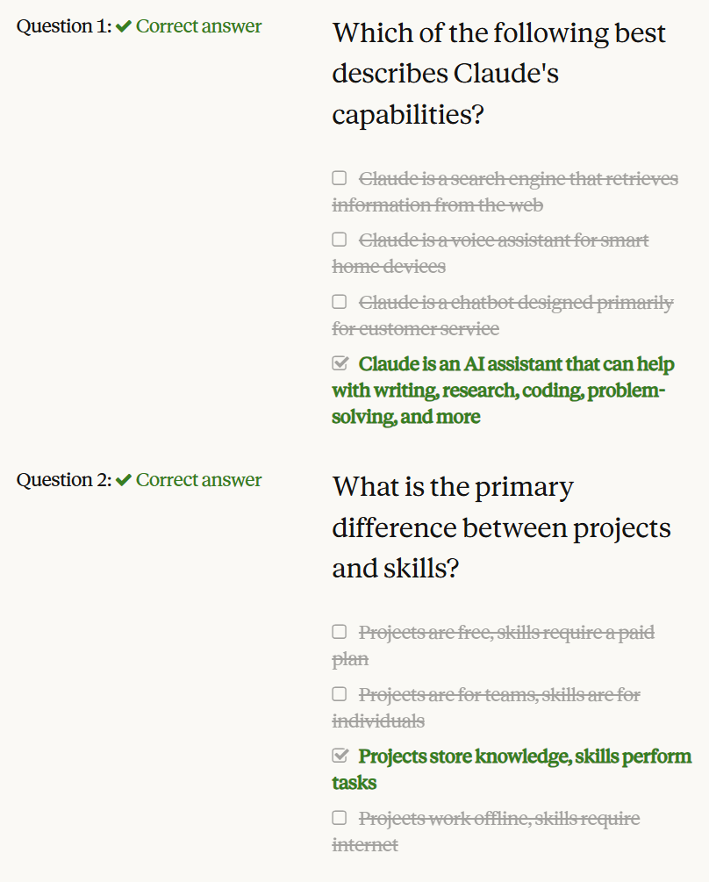
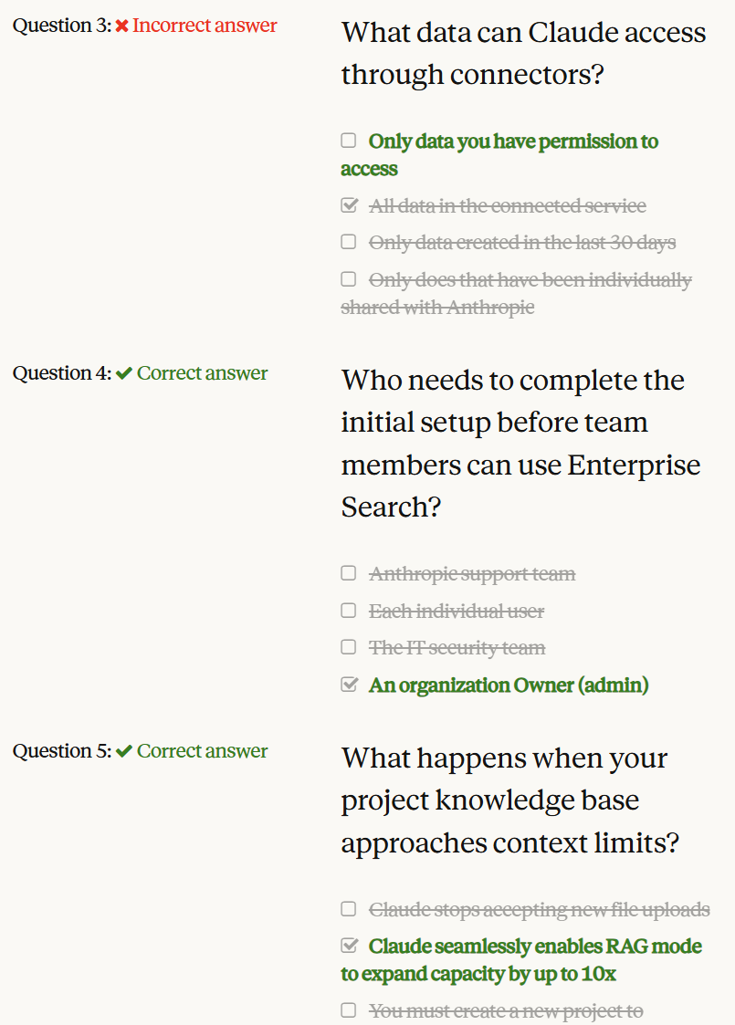
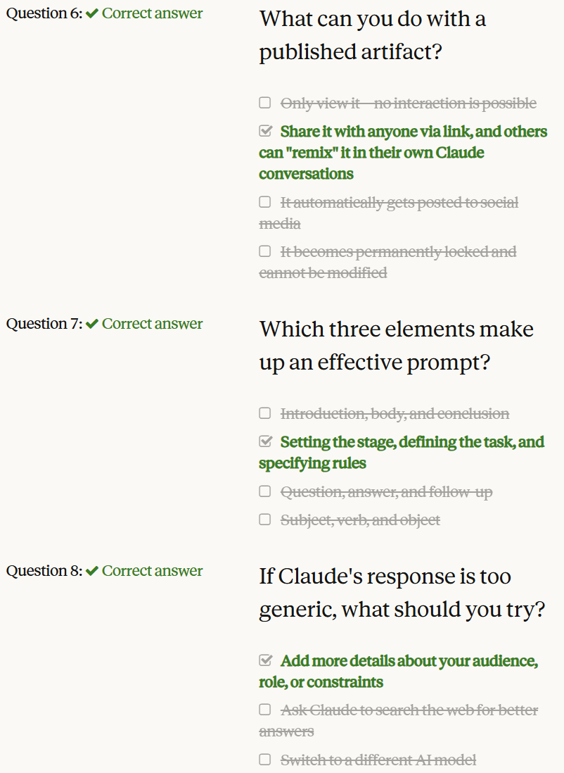

Slide 55


